Slide 1

Overview of AI
Fundamentals of AI
Prakash Pimpale, Scientist E
Knowledge Based Computer Systems/KBCS
A premier R&D organization of the Ministry of Electronics​ and Information Technology (MeitY), Govt. of India​

Slide 2
Index
Artificial Intelligence - The definition
AI software and non-AI software
Generative AI Evolution
Generative AI Action
GenAI for Individual use
GenAI-fy Software Applications

Slide 3
Artificial Intelligence - The Definition
John McCarthy, one of the founding fathers of AI
"AI is the science and engineering of making intelligent machines."
Stuart Russell & Peter Norvig, authors of Artificial Intelligence: A Modern Approach
"Artificial Intelligence is the study of agents that receive percepts from the environment and perform actions."

Slide 4
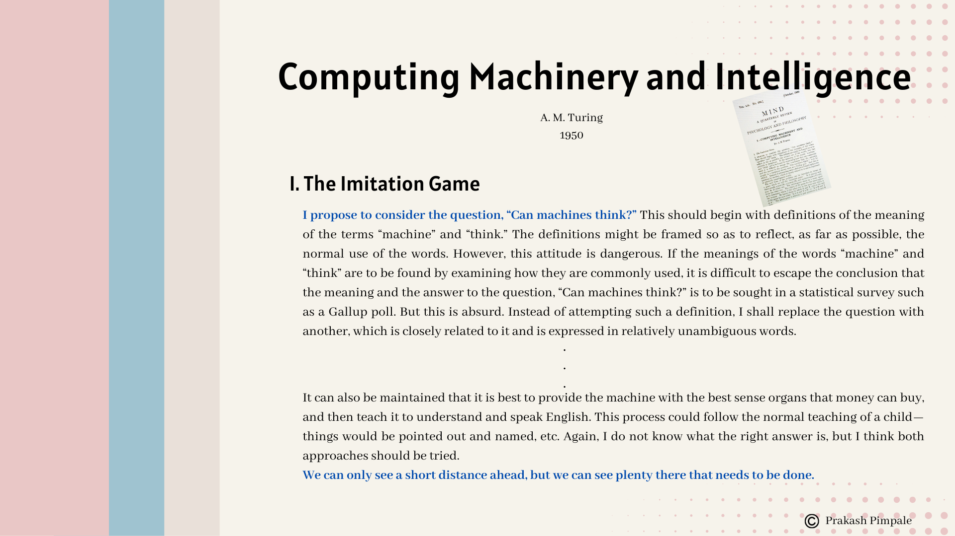
Artificial Intelligence - The Definition

Slide 5
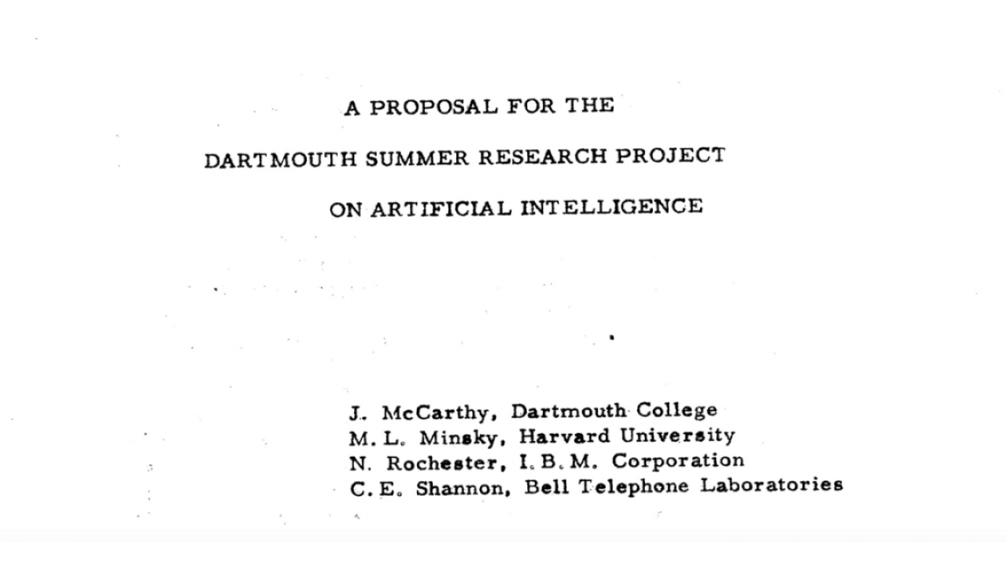
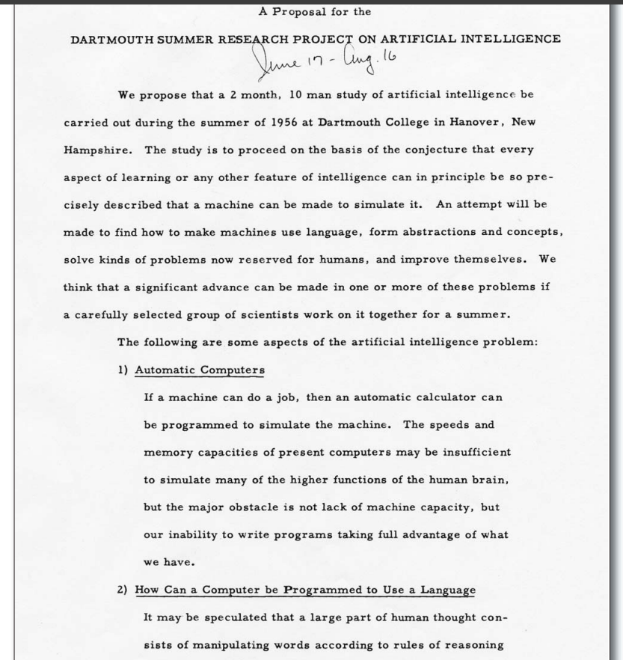
Artificial Intelligence - The Definition
1956

Slide 6
AI Software and non-AI Software
John McCarthy, one of the founding fathers of AI
"AI is the science and engineering of making intelligent machines."
Stuart Russell & Peter Norvig, authors of Artificial Intelligence: A Modern Approach
"Artificial Intelligence is the study of agents that receive percepts from the environment and perform actions."

Slide 7
AI Software and non-AI Software
non-AI Software
Rules
Output
An Application Developer
Input
Software Users

Slide 8
AI Software and non-AI Software
The New
Output
AI Maker
Software
Output
Rules
The AI Software
(Production)
The AI Developer
Input
New Inputs
Software Users

Slide 9
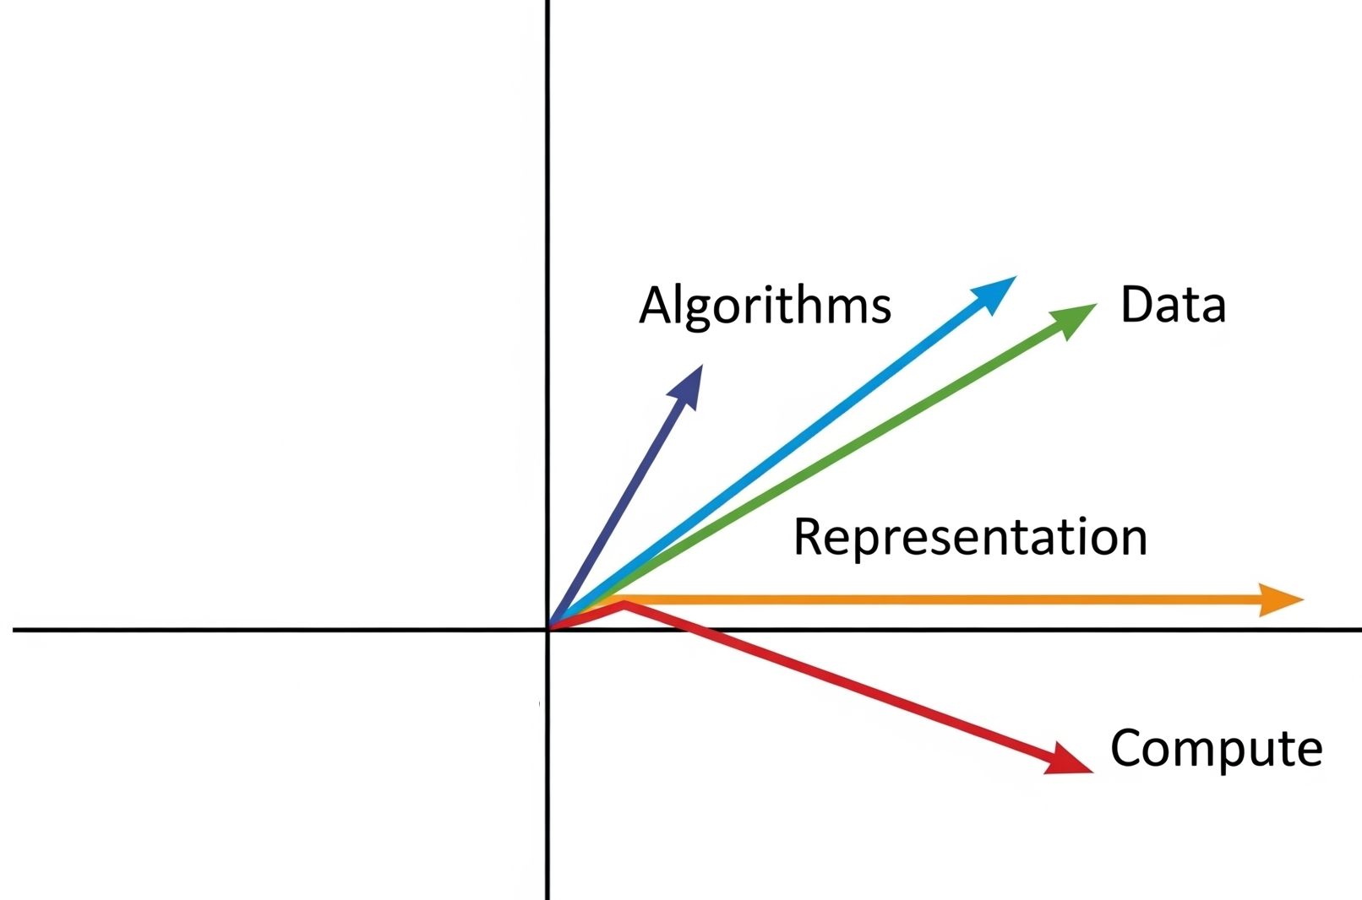
Generative AI Evolution
Multiple dimensions of the AI evolution
Algorithms
Representation
Data
Compute

Slide 10
The Representation Evolution
Raw Text
Text: Ram killed Ravan.
Representation: 'Ram killed Ravan.'
Tokens
Text: Ram killed Ravan.
Representation: ['Ram', 'killed', 'Ravan', '.']

Slide 11


















The Representation Evolution
Bag-of-Words / TF‑IDF / One‑Hot Encoding
Text:
T1 – Ram killed Ravan.
T2 – Ram married sita.
T3 – Ram went to bank to kill Ravan.
One-hot
 | Ram | Kill | Ravan | Marry | Sita | Went | To | Bank | .
T1 | 1 | 1 | 1 | 0 | 0 | 0 | 0 | 0 | 1
T2 | 1 | 0 | 0 | 1 | 1 | 0 | 0 | 0 | 1
T3 | 1 | 1 | 1 | 0 | 0 | 1 | 1 | 1 | 1
TF-IDF​
 | Ram | Kill | Ravan | Marry | Sita | Went | To | Bank | .
T1 | 1 | 1 | 1 | 0 | 0 | 0 | 0 | 0 | 1
T2 | 1 | 0 | 0 | 1 | 1 | 0 | 0 | 0 | 1
T3 | 1 | 1 | 1 | 0 | 0 | 1 | 2 | 1 | 1

Slide 12



















Representation – Word Embeddings
Basically, Static Word Embeddings
Word2Vec, GloVe, FastText, etc.
Embeds words into continuous vector space based on their context
Words appearing in similar contexts are placed close together
Word | Embedding (5 Dimensional)
ram | [0.2, -0.1, 0.3, 0.8, -0.2]
kill | [0.1, -0.3, 0.7, 0.4, 0.0]
marry | [0.3, 0.1, -0.4, 0.6, 0.1]
ravan | [0.0, -0.2, 0.6, 0.5, 0.3]

Slide 13
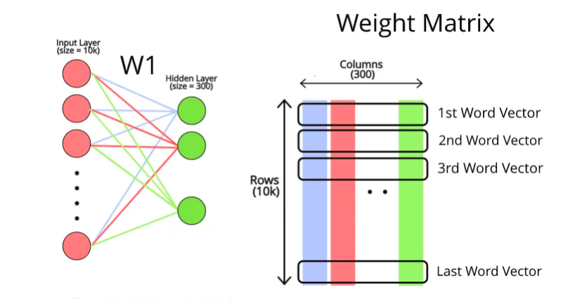
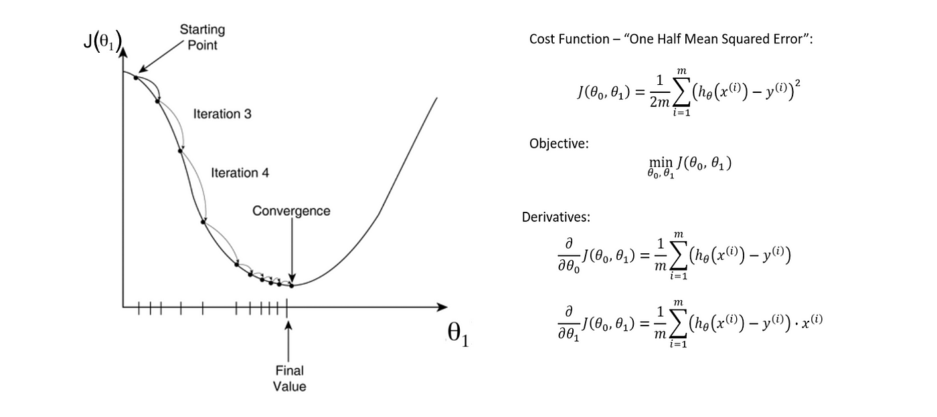
Representation – Word Embeddings
The word embeddings are learned using Artificial Neural Network (ANN) to Predict context word given a target word or target word given context words
(target, context) > (ram, killed), (killed, ravan)…

Slide 14
Representation – Contextual & Transformer
Contextual Embeddings
Non-static word embeddings
Embeddings for a word change in context of the surrounding words
"The bank of the river" → "bank" = [0.1, 0.2, ...]
"The bank approved my loan" → "bank" = [0.8, -0.1, ...]
Can be achieved using LSTM, Bi-LSTM or transformer-based architectures

Slide 15
Representation – Contextual & Transformer
Transformer Architecture
Uses self-attention to understand deep context and relationships
Sentence: Ram killed Ravan.
Tokens: ["Ram", " killed", " Ravan","."] with their own embedding vector (word embedding +positional embedding)
Meaning of the 'Ram' is understood in context of the 'killed' and 'Ravan' - attention and similarly for other words
Result:
Model understands that 'Ram' is the doer, 'Ravan' is the object, and 'killed' is the action.
Examples - BERT, GPT, etc.

Slide 16
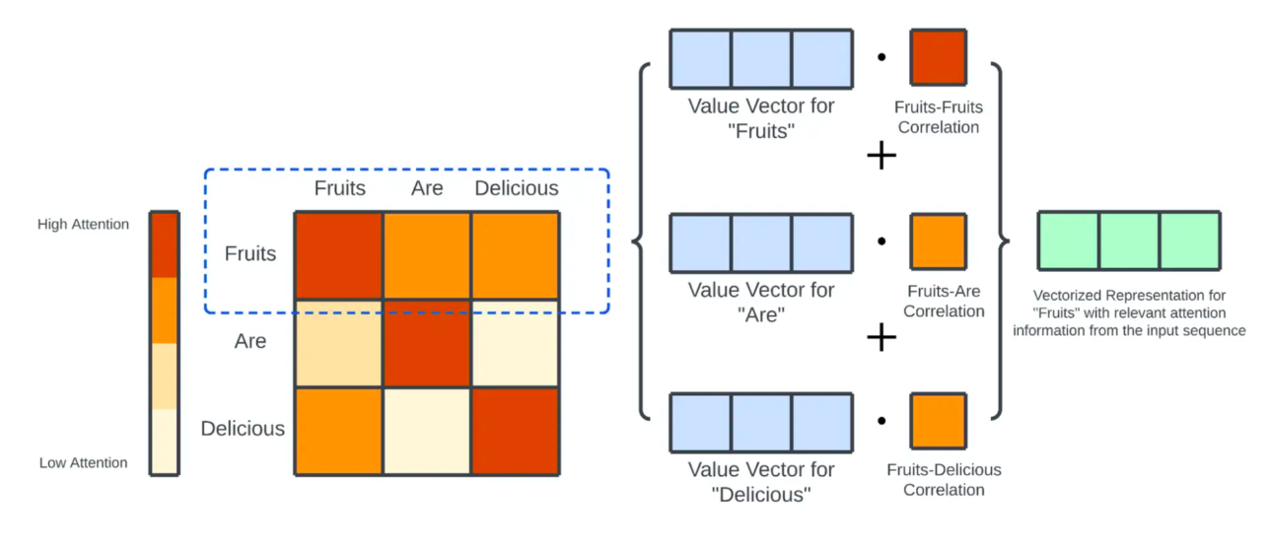
Representation – Contextual & Transformer

Slide 17
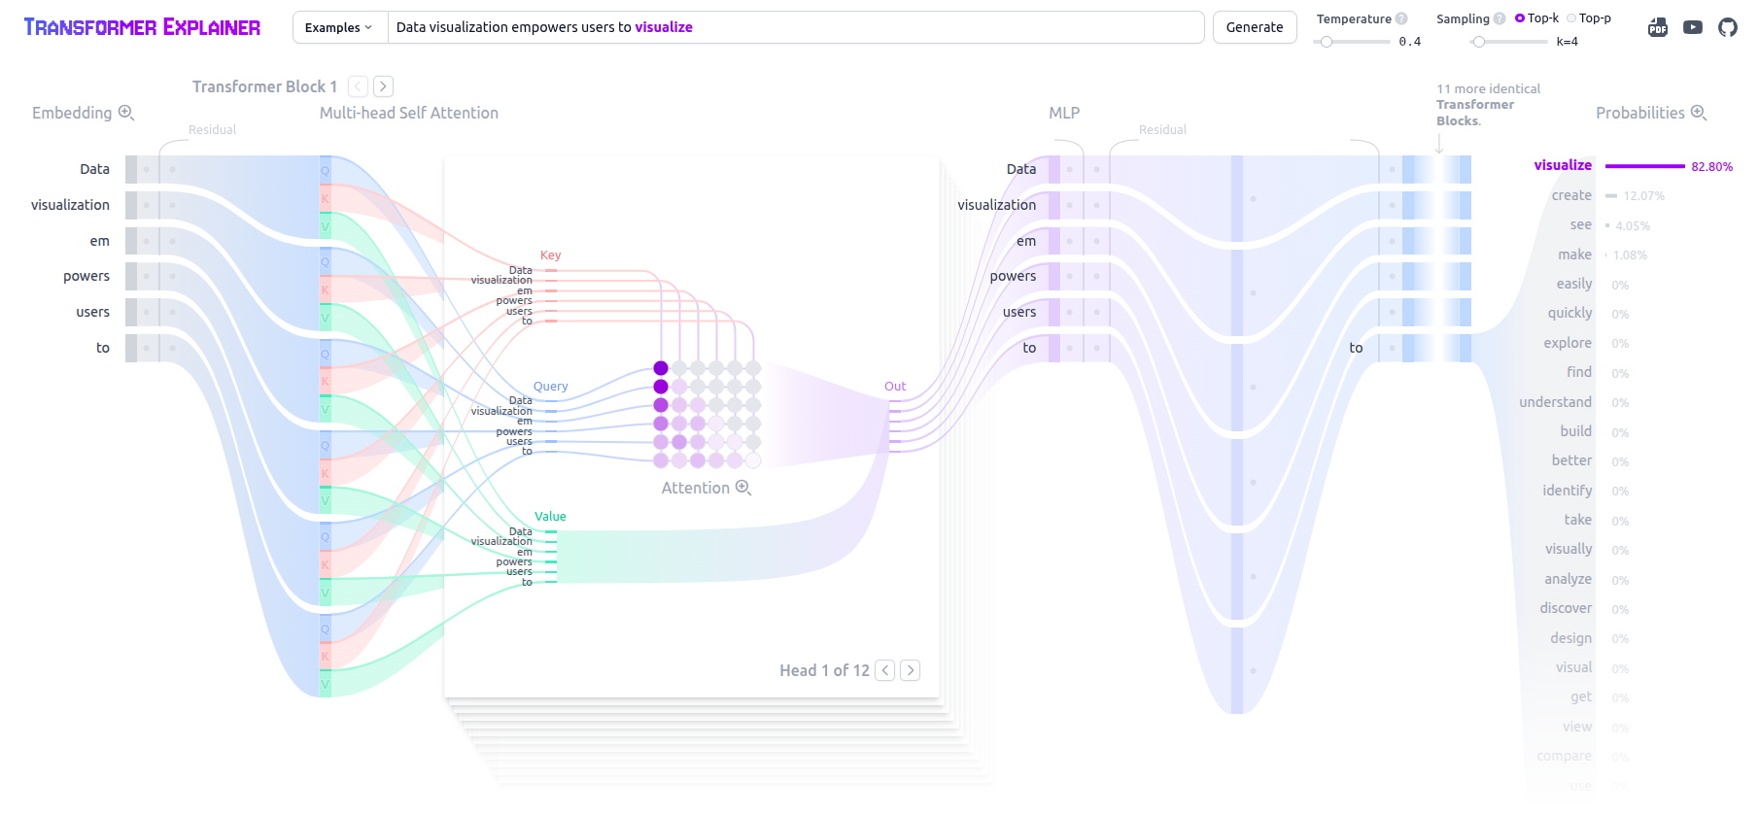
Representation – Contextual & Transformer
https://poloclub.github.io/transformer-explainer/

Slide 18
Generative AI Action
This evolutions has made us reach a point where we can model a language accurately as a Large Language Model - LLM
LLMs are models built by
Scaling transformer architecture to billions of parameters
And training it on vast text corpora
LLMs learn from training – not explicitly
Context: Word meaning in different contexts. Ex. 'bank' of river vs 'bank' loan
Syntax: Grammar and structure of sentences. Ex. Ram kills Ravan > subject-verb-object
Semantics: Word meanings and relationships. Ex. doctor is to hospital as teacher is to school
World Knowledge: Factual, encyclopedic, and common knowledge. Ex. Taj Mahal is in Agra.
LLMs are capable of generating next word given a context; generated content is completely from what it has learned/inferred from!

Slide 19
Generative AI Action
GPT – Generative Pretrained Transformer – a foundational model
ChatGPT – GPT + special training for dialogue + chat UI + safety layers
Beyond Text
Modality | Model Examples
Text (LLMs) | GPT-4, Claude, LLaMA, Gemini, T5, Command R
Image | DALL·E, Midjourney, Stable Diffusion, Imagen
Audio | Bark, Jukebox, AudioLM, VALL-E
Video | Sora, Runway Gen-2, Pika, Luma
Code | Codex, Code LLaMA, StarCoder, DeepSeek
Multimodal | GPT-4o, Gemini, Claude 3, BLIP-2

Slide 20
GenAI for Individual use
Time Management: "Help me organize my day. I have a meeting at 10 AM, need to finish a report by 3 PM, and want to exercise for 30 minutes. Suggest a schedule."
Learning a Skill: "Teach me five basic phrases in Spanish for greeting people, with pronunciation tips, and suggest a daily practice routine."
Budgeting: "I have $50 to spend on groceries this week. Suggest a shopping list for affordable, healthy meals and estimate the costs."
Stress Relief: "Give me a 10-minute relaxation exercise with step-by-step instructions I can do at home to unwind after a long day."
Email Drafting: "Write a polite, professional email to a colleague requesting a project update by end of day, keeping it under 100 words."
Meeting Prep: "Summarize this 500-word project brief into 3 key points for a 10-minute team meeting, and suggest two questions to ask for clarification."
Task Prioritization: "I have to draft a proposal, review a presentation, and respond to 15 emails today. Rank these tasks by urgency and suggest a timeline for an 8-hour workday."
Data Organization: "Create a simple template for a weekly report in bullet points, including sections for goals, progress, and challenges, that I can reuse."
Problem Solving: "My team missed a deadline because of poor communication. Suggest three actionable steps to improve our workflow and prevent this in the future."
www.grok.com ​
www.chatgpt.com​
https://gemini.google.com​
www.perplexity.ai ​

Slide 21
GenAI for Individual use - Careful​
Hallucination: Might generate plausible-sounding but completely fabricated information. For example, if you ask for historical details, it could invent events that never happened. Always cross-check critical facts with reliable sources.
Inaccuracy: The responses might contain errors, especially with complex or niche topics. If you ask for financial advice or technical specs, it could miss nuances. Double-check with experts or primary data when precision is key.
Bias: It's trained on vast datasets that can reflect human biases—social, cultural, or otherwise. If you ask for opinions or analysis, the output might unintentionally lean one way. Use it as a starting point, not a final judgment.
Over-Reliance: It’s tempting to let it handle everything, but it can’t replace human judgment. For instance, blindly following a generated schedule might ignore real-world constraints. Stay engaged and tweak the suggestions as needed.
Privacy Risks: Sharing sensitive info—like personal details or proprietary business data—could be a mistake. It doesn't store your input, but it’s best to avoid feeding it anything confidential, just to be safe.

Slide 22
GenAI-fy Software Applications
Capability | Description | Example Use Cases
Natural Language Processing (NLP) | Understand and generate human language | Chatbots, summarization, sentiment analysis
Computer Vision | Interpret images and videos | OCR, face detection, quality control in factories
Recommendation Systems | Personalize based on user behavior | Netflix, YouTube, e-commerce
Predictive Analytics | Forecast future values from patterns | Stock prediction, sales forecasting
Speech Recognition & TTS | Convert speech to text & vice versa | Voice assistants, IVR, dictation apps
Generative AI | Create new content (text, code, images, etc.) | Content creation, code generation, game design
Autonomous Agents | Software that acts on user’s behalf | Email sorting bots, RPA, travel assistants

Slide 23
GenAI-fy Software Applications
Domain | Text LLM Use Cases | Multimodal LLM Use Cases
Customer Support | Chatbots, complaint classification, email reply generation | Image-based issue resolution, OCR on receipts/screenshots
Education & Learning | Tutoring, quiz generation, essay grading, language learning | Visual problem explanations, diagram interpretation
Enterprise Software | Meeting summarization, email drafting, report generation | Slide/image extraction from meetings, visual minutes
Document Intelligence | Contract QA, summarization, semantic document search (RAG) | Visual document parsing, charts-to-text explanation
Code Assistance | Code generation, code explanation, bug fixing, documentation | Code from screenshots, UI-based input to code
Business Analytics | Natural language to SQL, spreadsheet explanation, data insights | Chart reading, table image analysis, voice-to-report
Legal & Compliance | Policy simplification, redaction, compliance verification | Legal doc image summarization, scanned form parsing
Agentic Automation | Goal decomposition, API orchestration, research assistance | Image+text planning, PDF understanding with layout awareness

Slide 24
GenAI-fy Software Applications ​
Prompt Engineering
Write prompts to get desired responses from a pre-trained model
Quick results without any training or customization
Function Calling / Tool Use – in Agents
Let the LLM invoke external tools (search, code, calculator) based on prompts
Make LLMs to act like intelligent agents that interact with other systems
Retrieval-Augmented Generation (RAG)
Combine LLMs with a vector database to bring in private, real-time data
Enhance LLMs to retrieve and generate from dynamic or proprietary data from your DB
Fine-Tuning
Update some model weights with domain-specific datasets
When you want deep domain adaptation
Train a Model from Scratch
Build and train your own LLM from tokens to weights
need full control, handle unique languages, or build foundational IP

Slide 25
GenAI-fy Software Applications - Prompting
A prompt is a natural language or structured input that elicits a desired response from a generative model, framing the context, constraints, and intent of the task.
Simple Instructional Prompt / Zero-Shot
Summarize the following paragraph or attached document in one sentence.
Few-Shot Prompt
Q: What is the capital of France? A: Paris Q: What is the capital of Italy? A: Rome Q: What is the capital of Germany? A:
System + User Prompt (Chat Format)
[ {"role": "system", "content": "You are a helpful legal assistant."}, {"role": "user", "content": "Summarize this course manual in 5 bullet points."} ]

Slide 26
Thank you!
A premier R&D organization of the Ministry of Electronics​ and Information Technology (MeitY), Govt. of India​

